Slide 1





SUPER
Scholar's Unified Progress & Efficiency Resource
GROUP #5

Slide 2

YOU ARE THE
NEXT SUPER

Slide 3




Our Team
GADAH ALMUAIKEL
RAWAN ALMESHARI
2005069
2005140
BASHAIER ALAMOUDI
SHATHA ALSULAMI
2
2009894
2006023

Slide 4
Table Of Content
INTRODUCTION
TESTING
PROTOTYPE & FEATURES
FINAL DESIGN
LIMITATION AND FUTURE WORK
RESULT & CONCLUSION
3

Slide 5

Rawan Almeshari

Slide 6
Introduction

Slide 7

What is SUPER?
A web-based platform designed to enhance the PhD journey for students and coordinators at the Faculty of Computing and Information Technology, King Abdulaziz University.
why SUPER?
To address the lack of a unified system that integrates real-time academic tracking and efficient management tools for PhD students and coordinators.
4

Slide 8
Prototype & Features

Slide 9

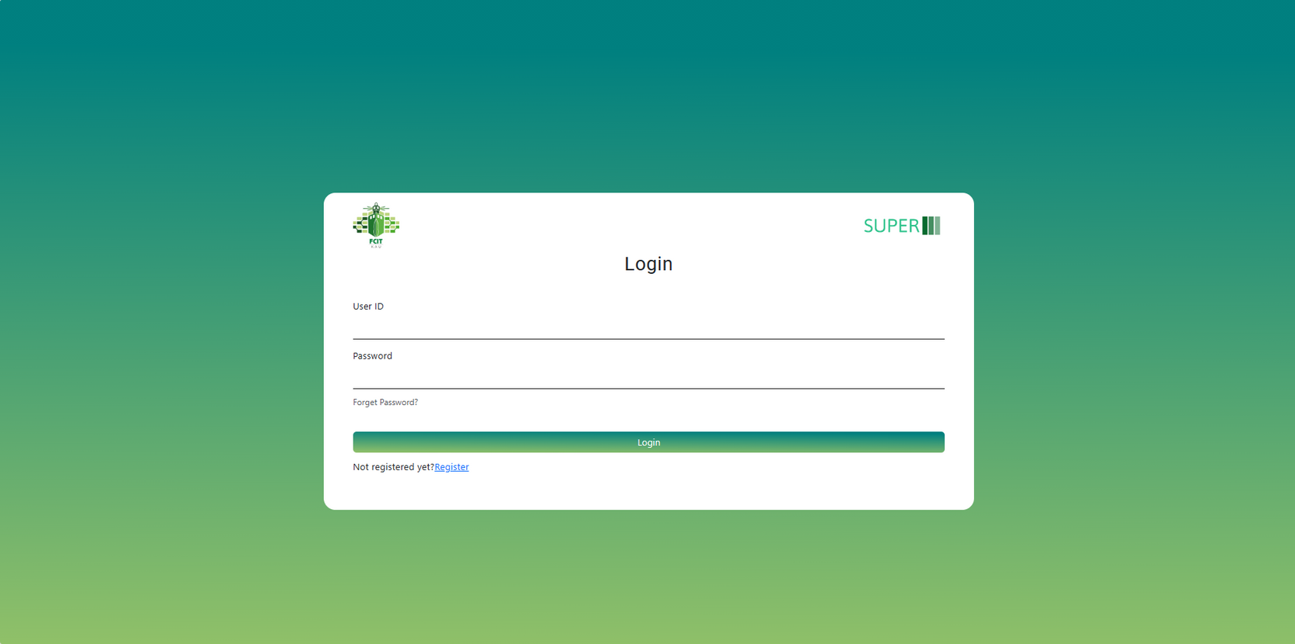
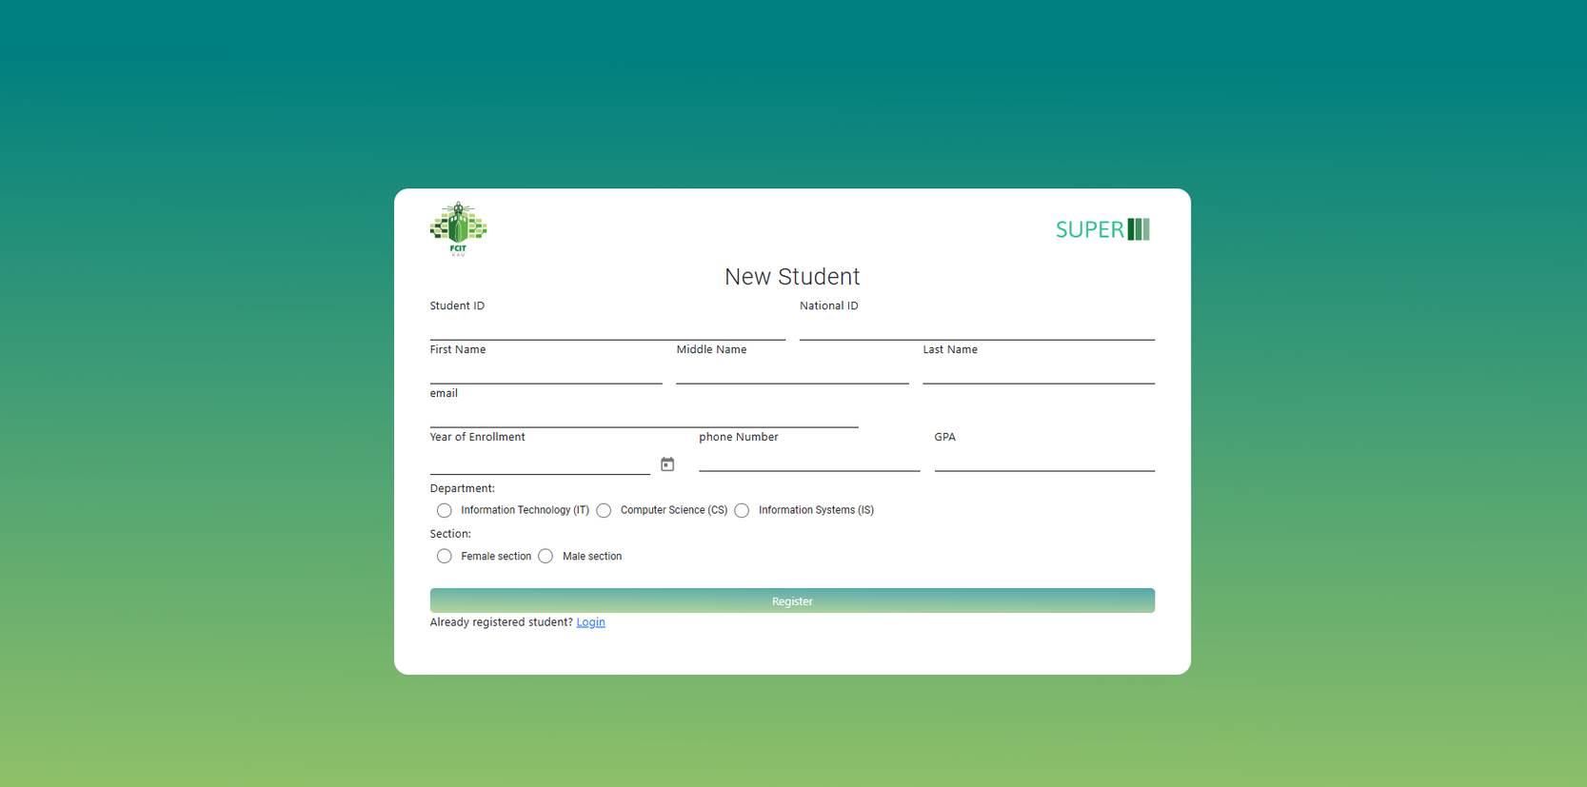
Prototype & Features
New Registration and Login Page
5

Slide 10
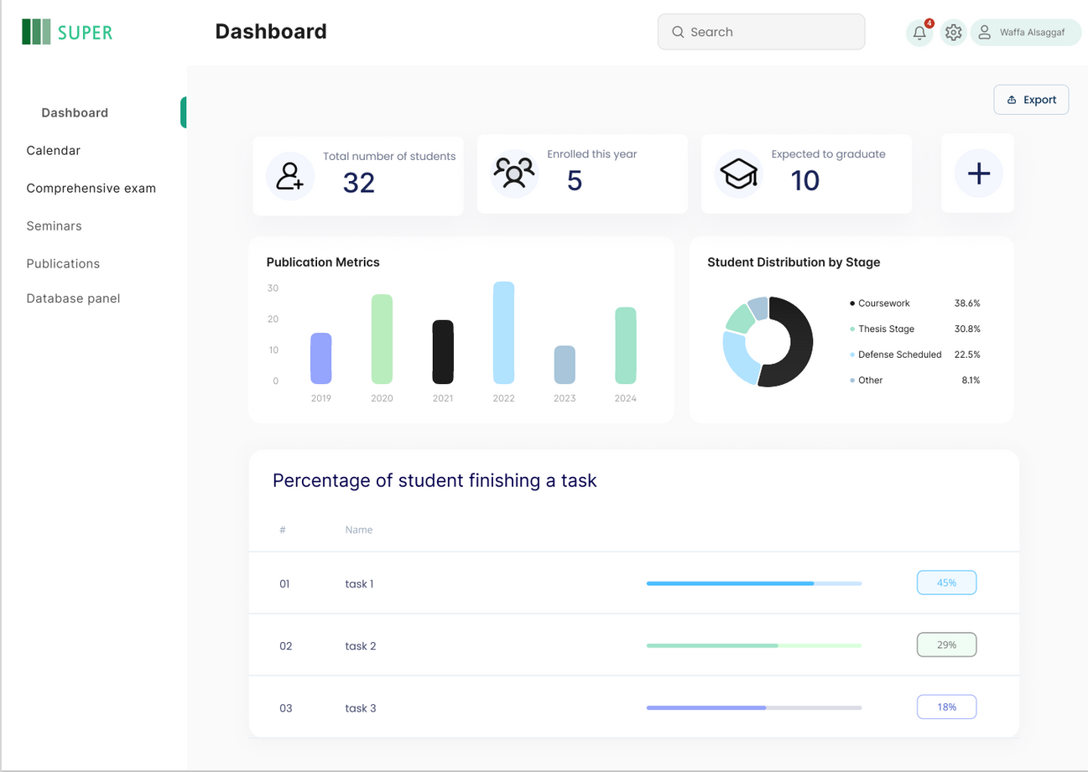
Prototype & Features
Dashboard For the Coordinator
6

Slide 11
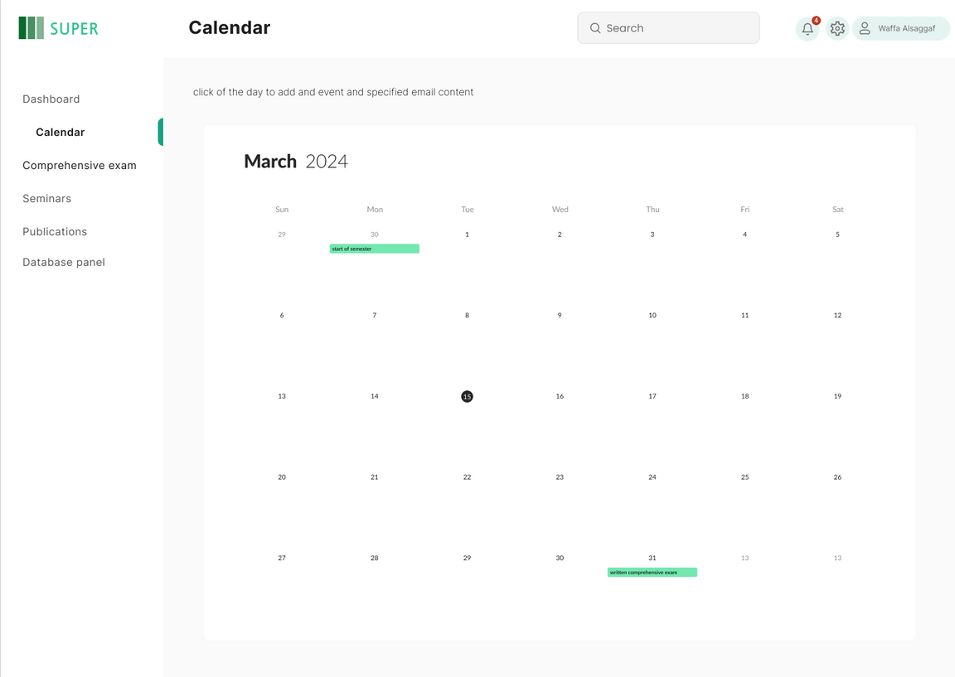
Prototype & Features
Real-Time Calender for both Students and Coordinators
7

Slide 12
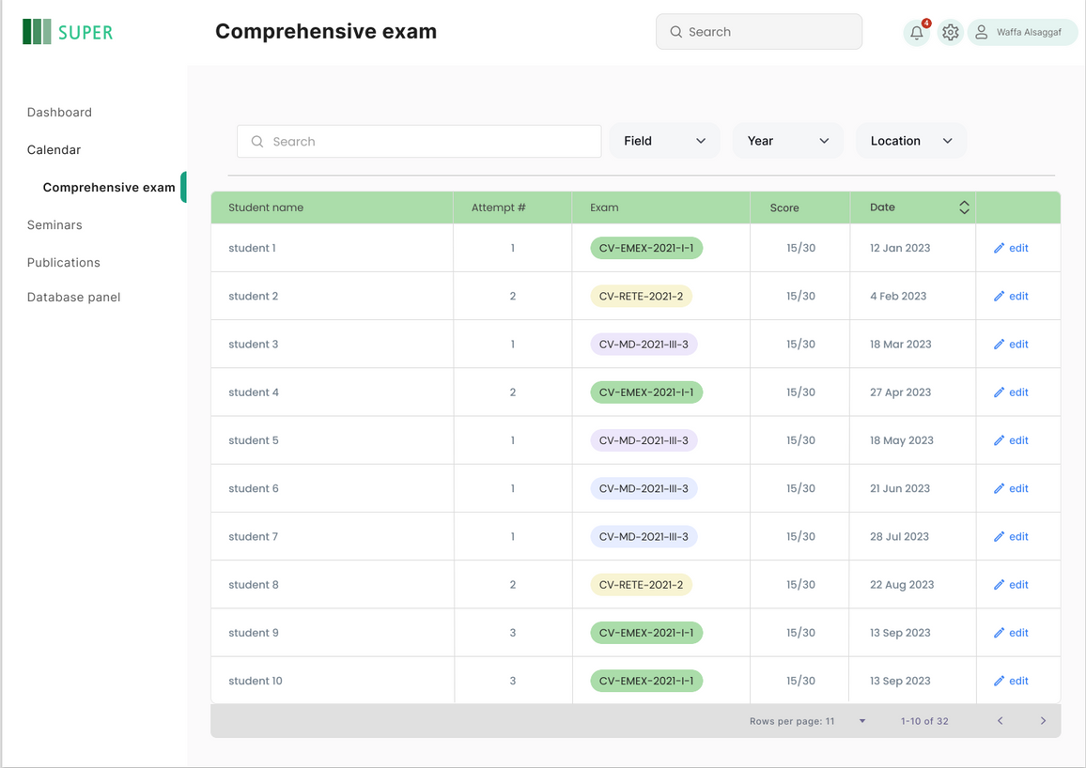
Prototype & Features
Comprehensive Exam Page: Displays details about comprehensive exams taken by students
8

Slide 13
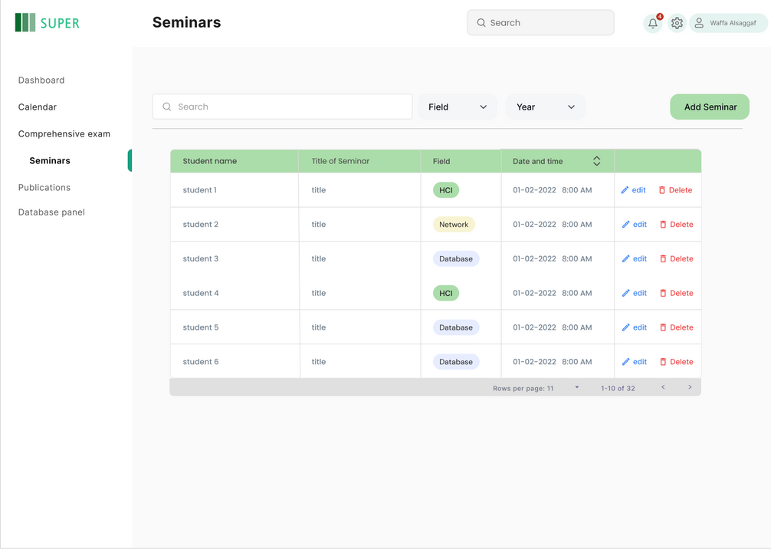
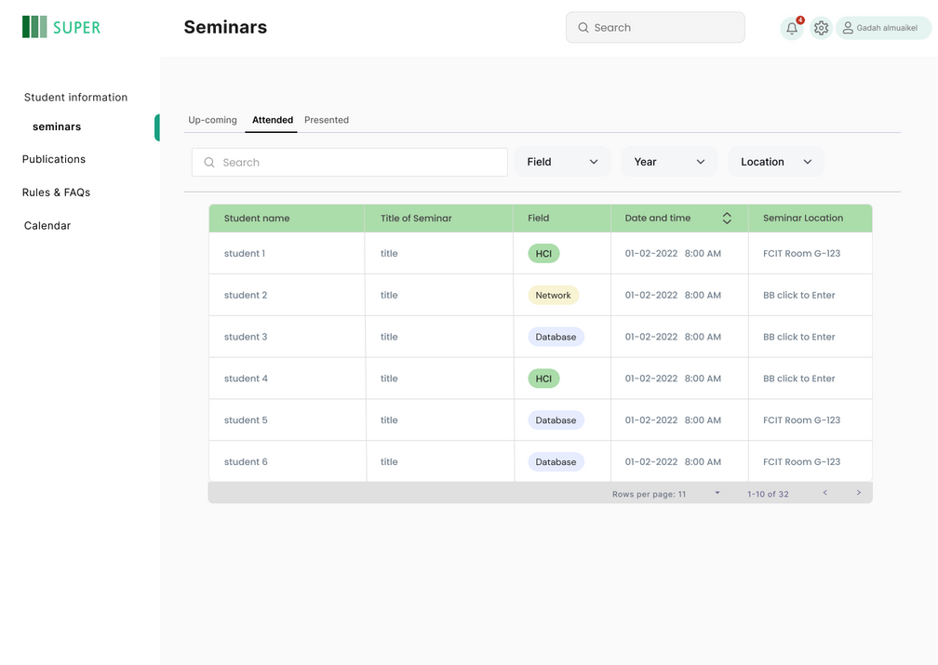
Prototype & Features
Lists upcoming seminars with details
9
Coordinator Page
Student Page

Slide 14
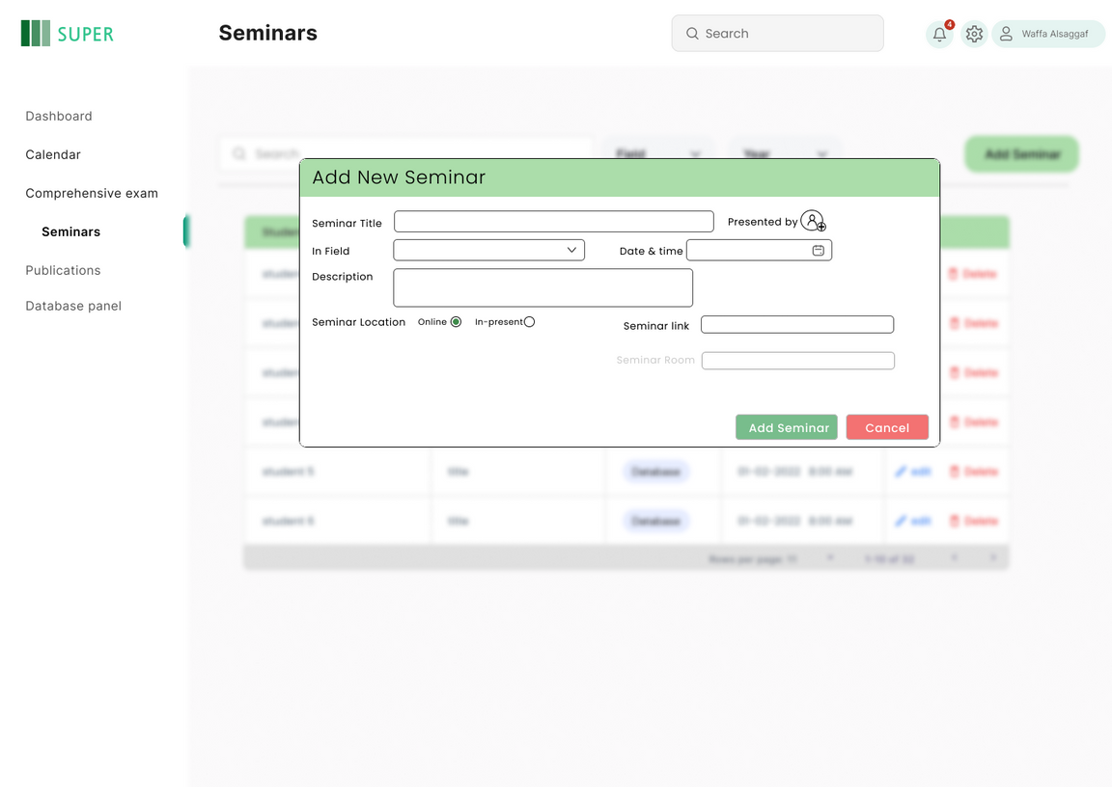
Prototype & Features
Adding Semniars
10

Slide 15
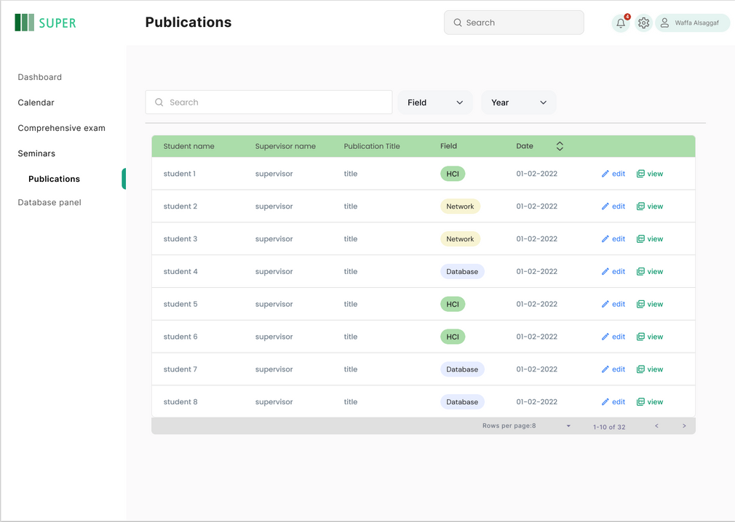
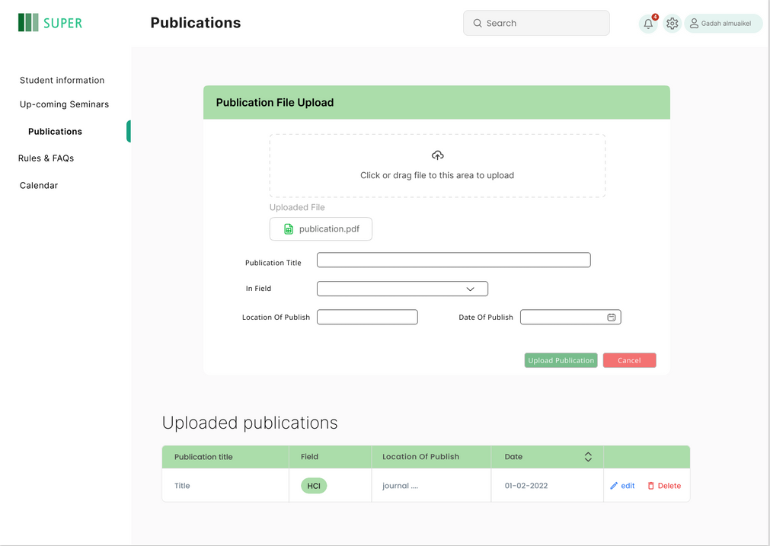
Prototype & Features
The Coordintor can view the student’s publications
The Student can Add his publications and view them
11

Slide 16
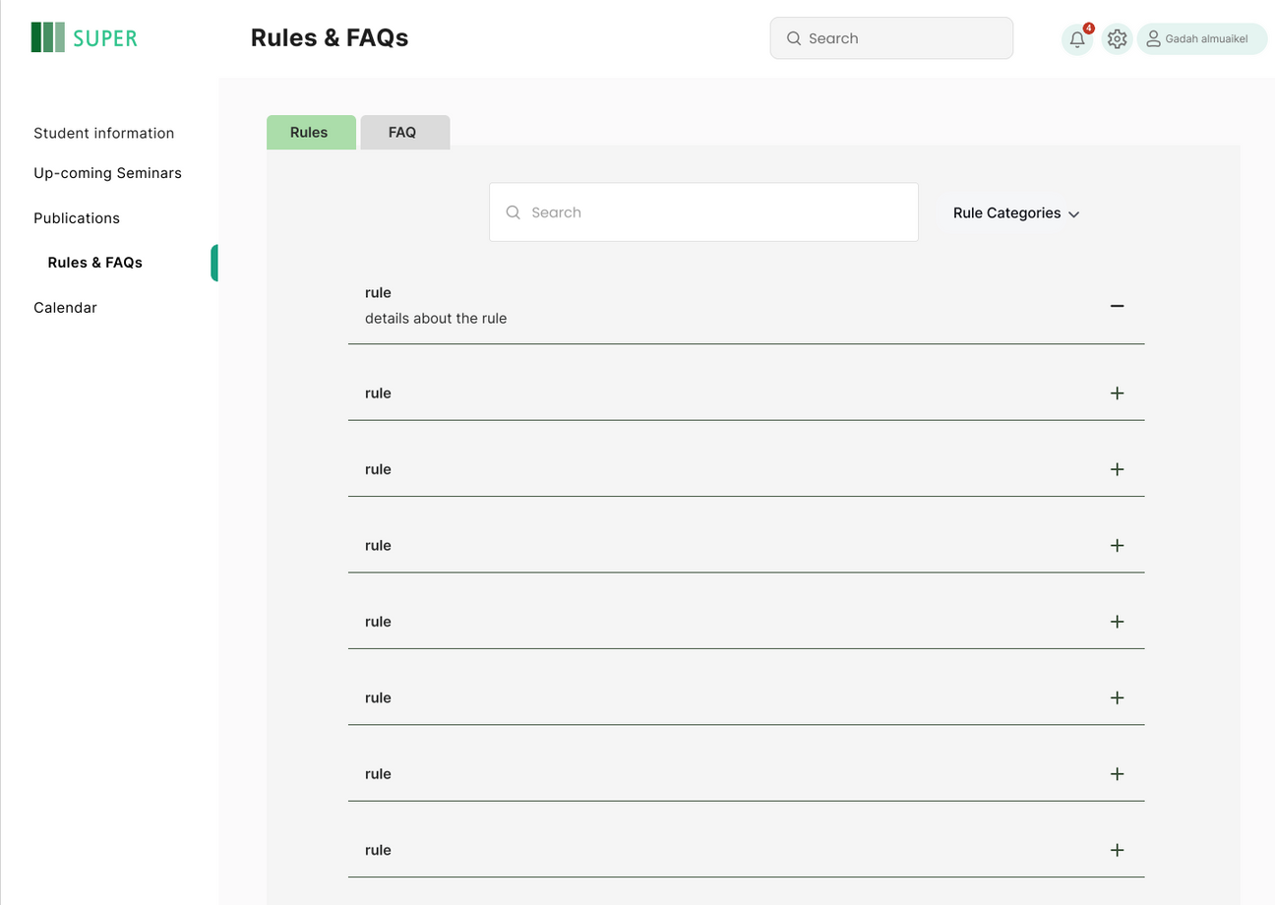
Prototype & Features
The Students Can search for a FAQs
12

Slide 17
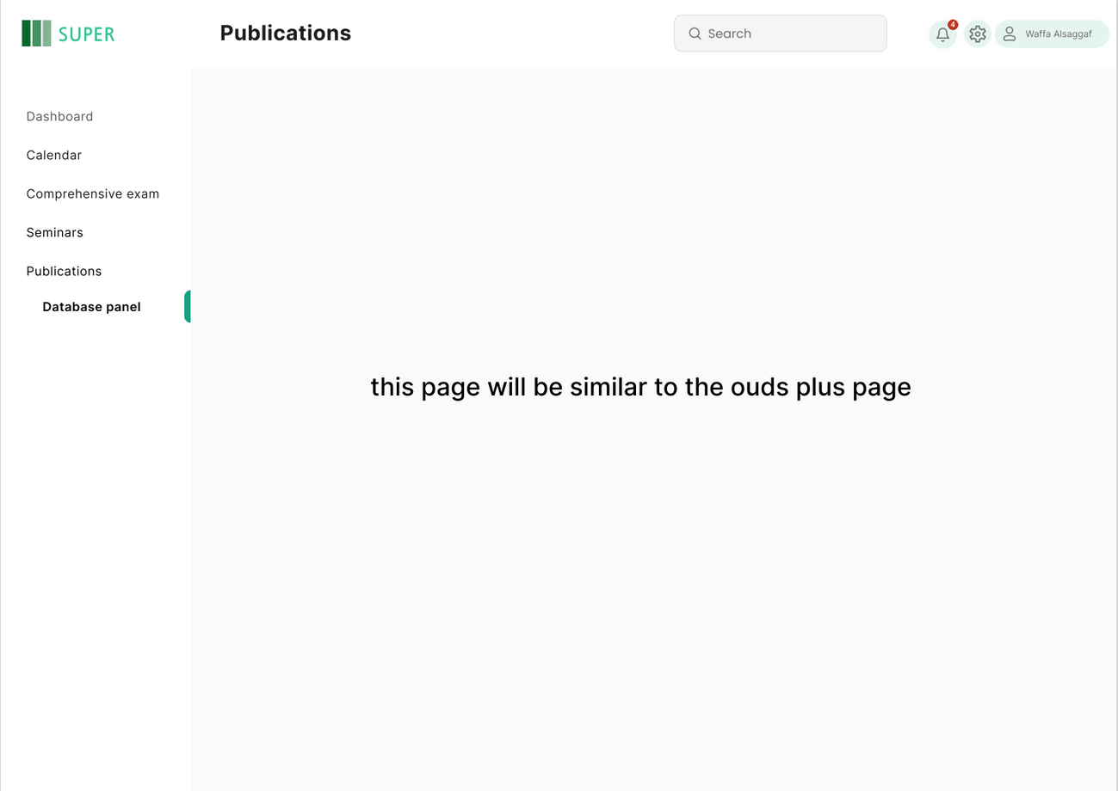
Prototype & Features
Database Panel for manging any student information
13

Slide 18
Shatha Alsulami

Slide 19
Final Design

Slide 20
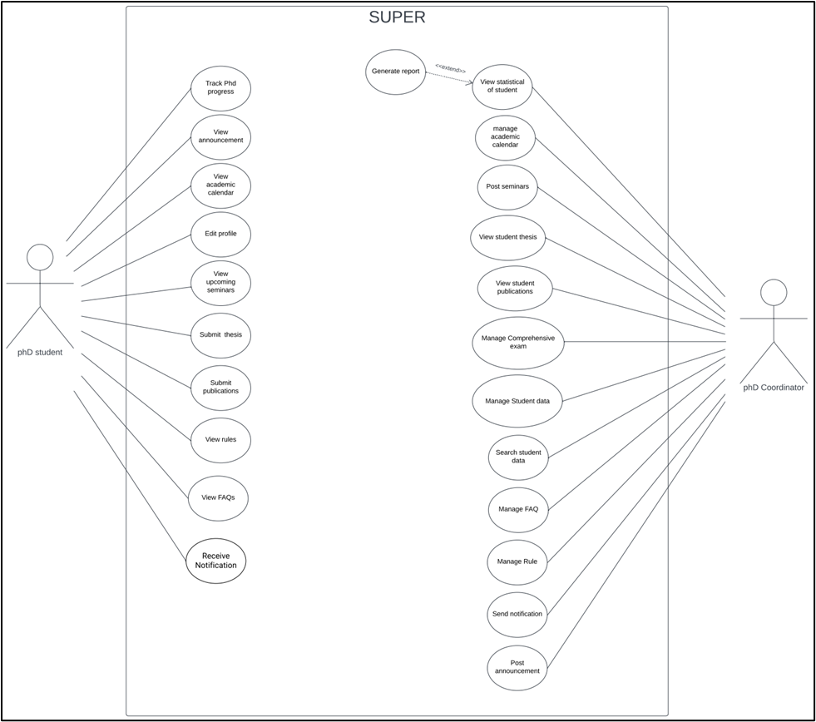
Use Case
PhD Student
PhD Coordinator
OLD
14

Slide 21
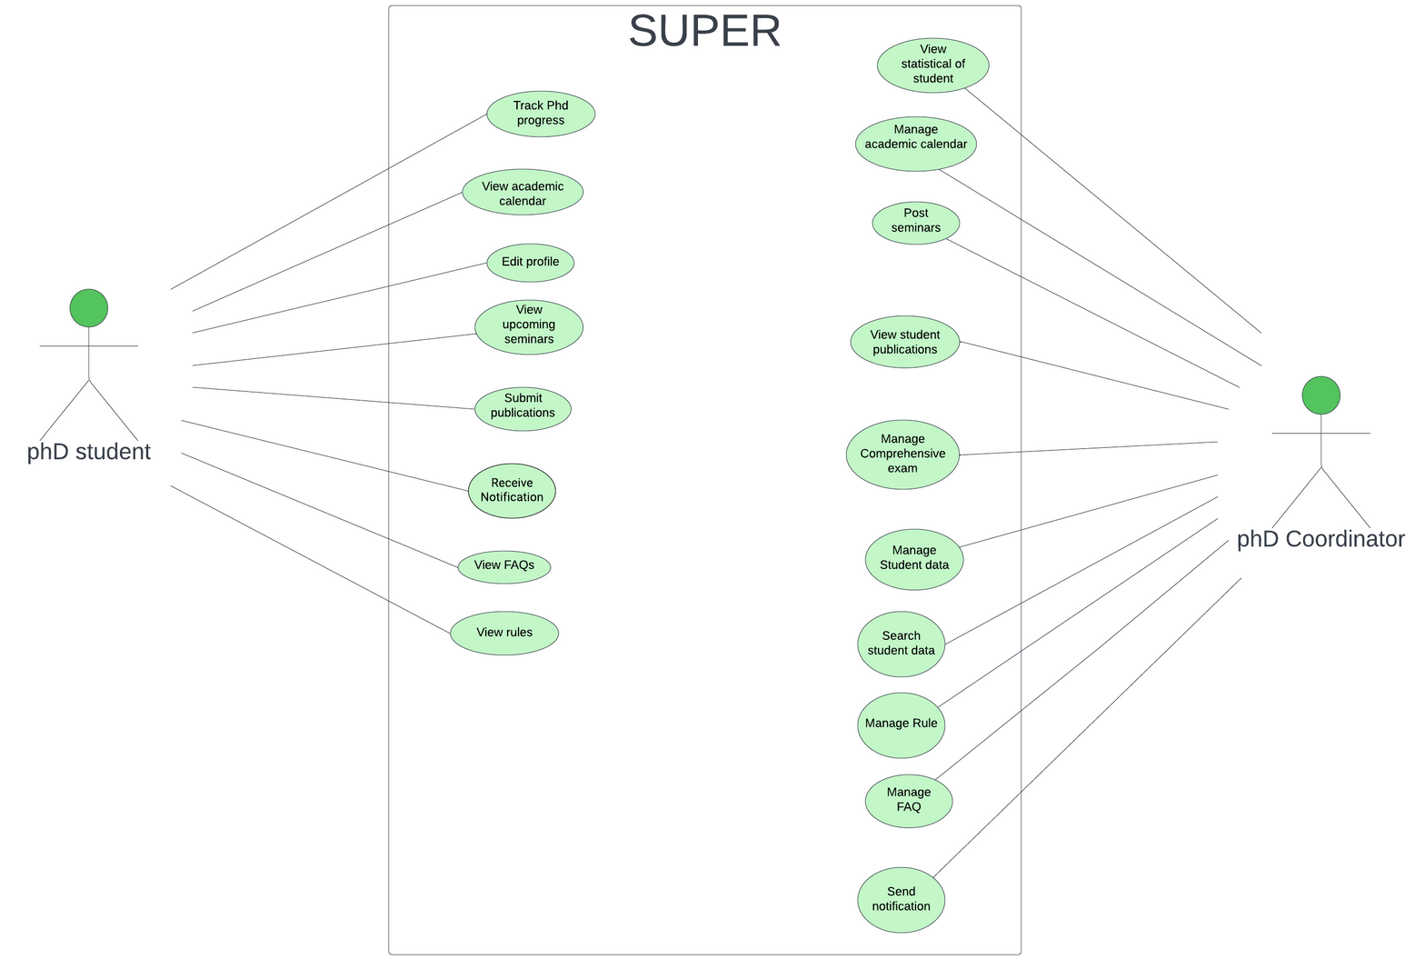
Use Case
PhD Student
PhD Coordinator
NEW
15

Slide 22
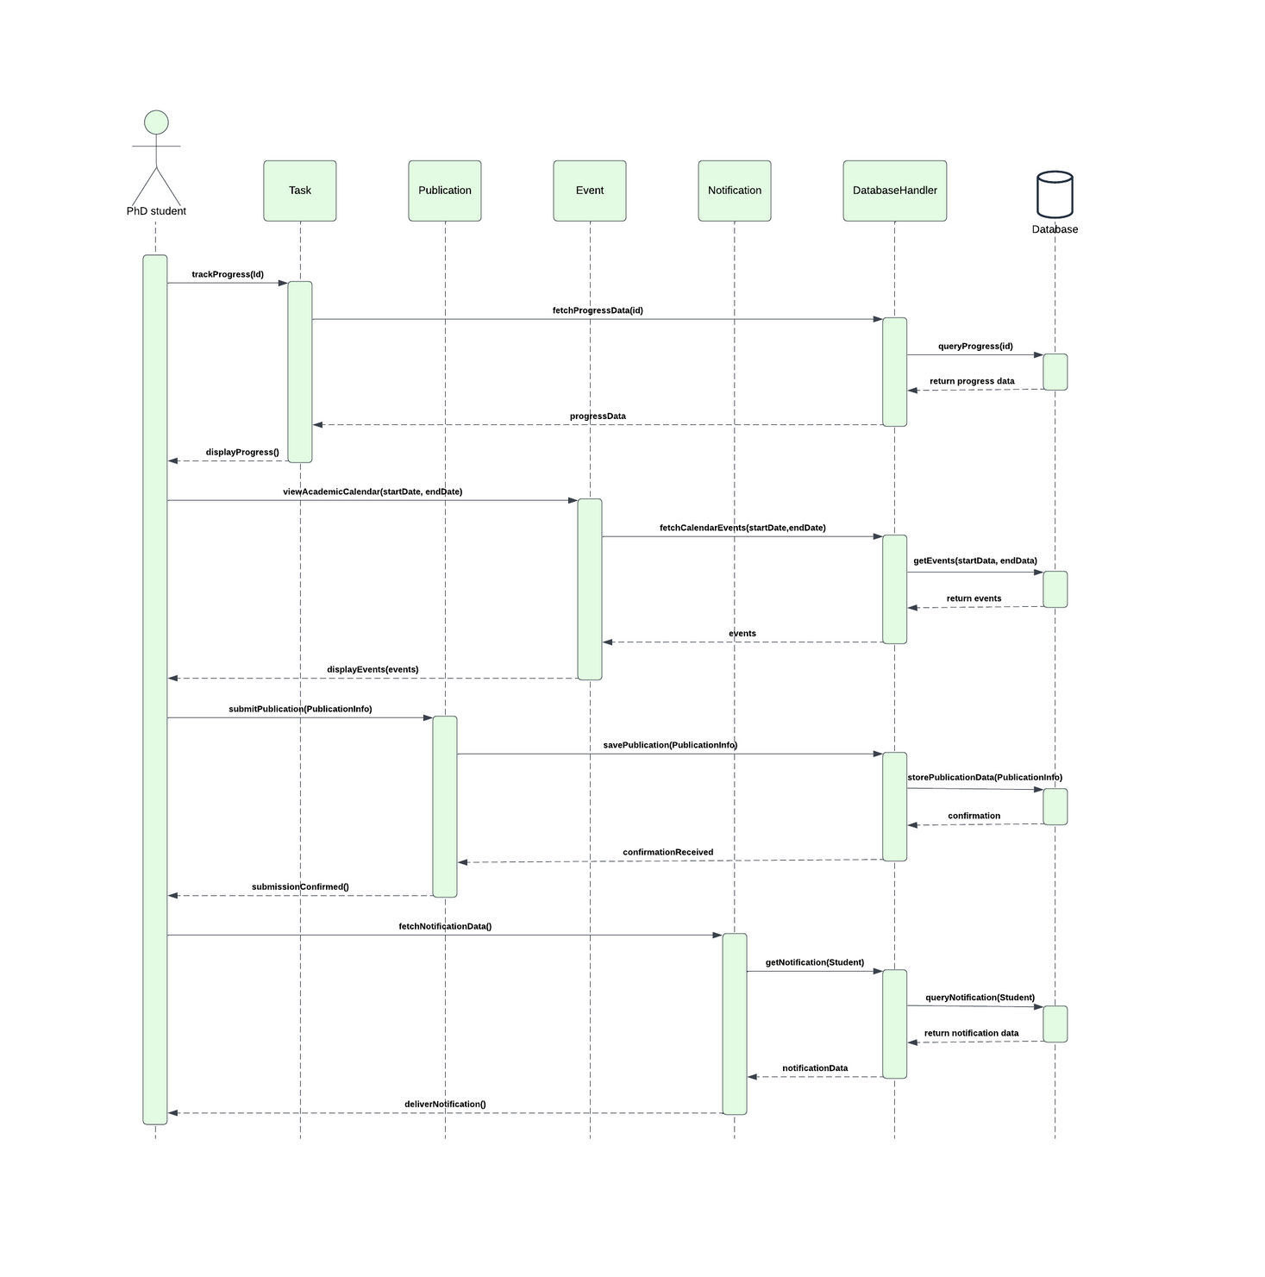
Sequence Diagram
OLD
16

Slide 23
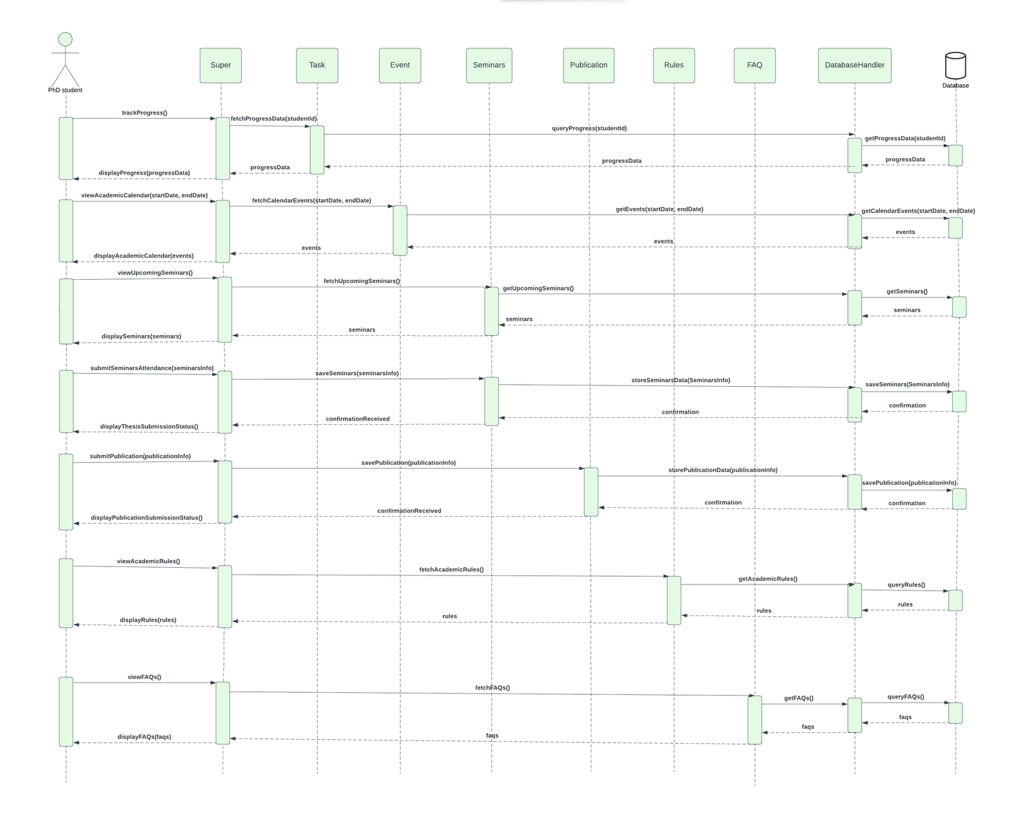
Sequence Diagram
NEW
17

Slide 24
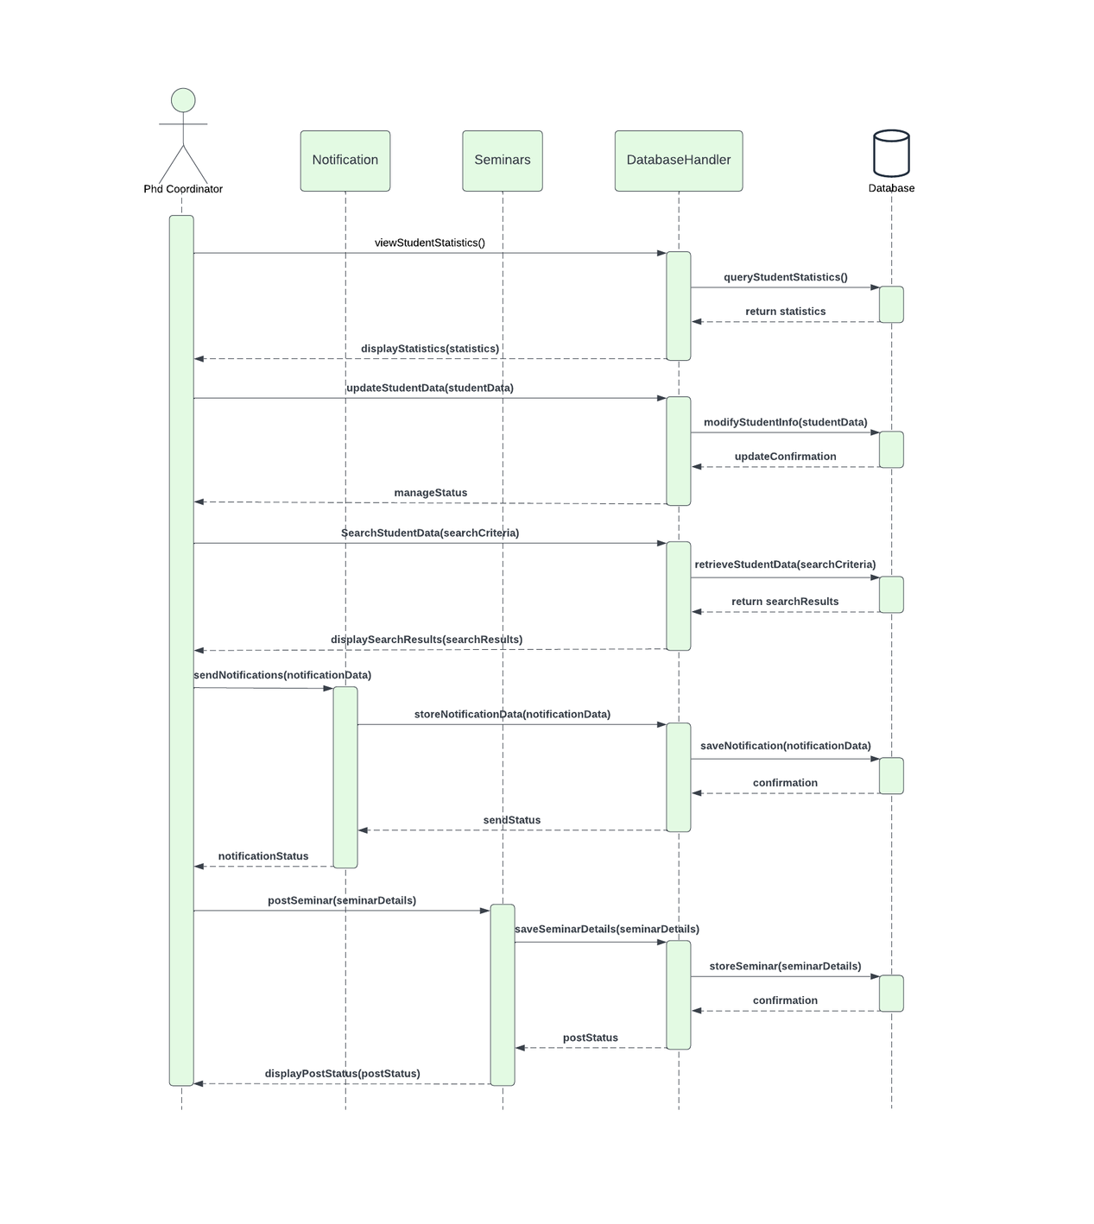
Sequence Diagram
OLD
18

Slide 25
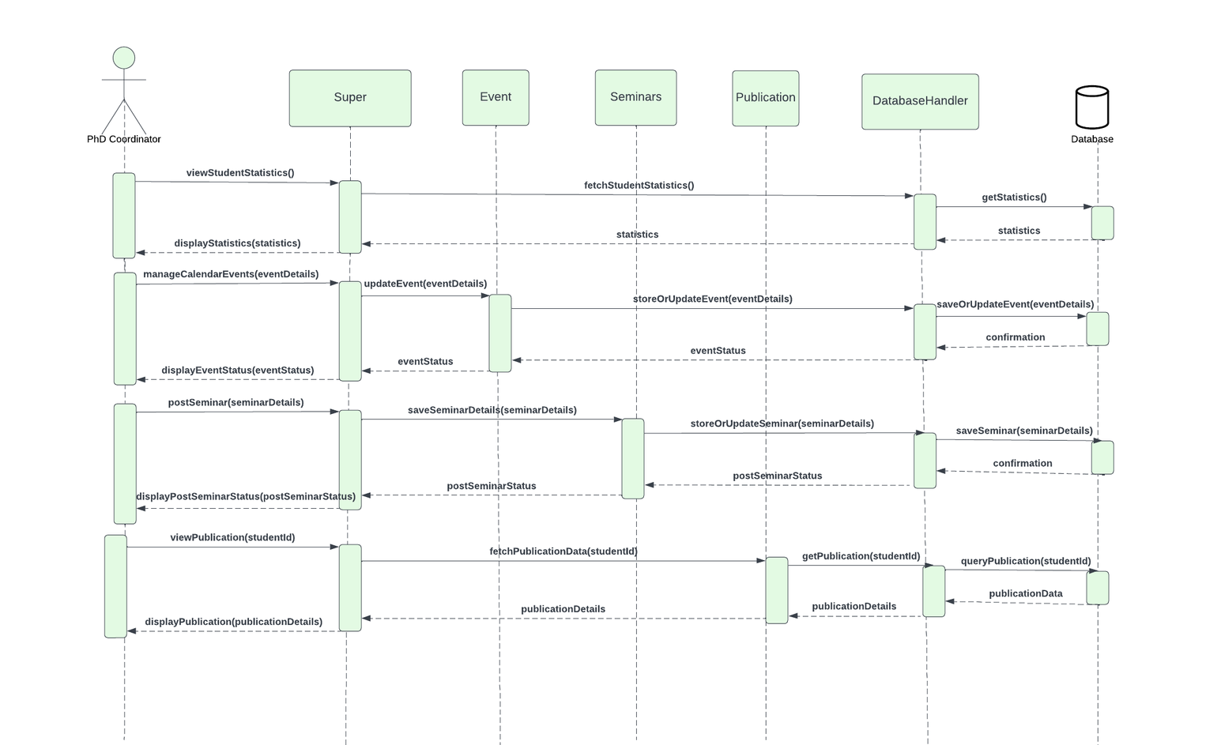
Sequence Diagram
NEW
19

Slide 26
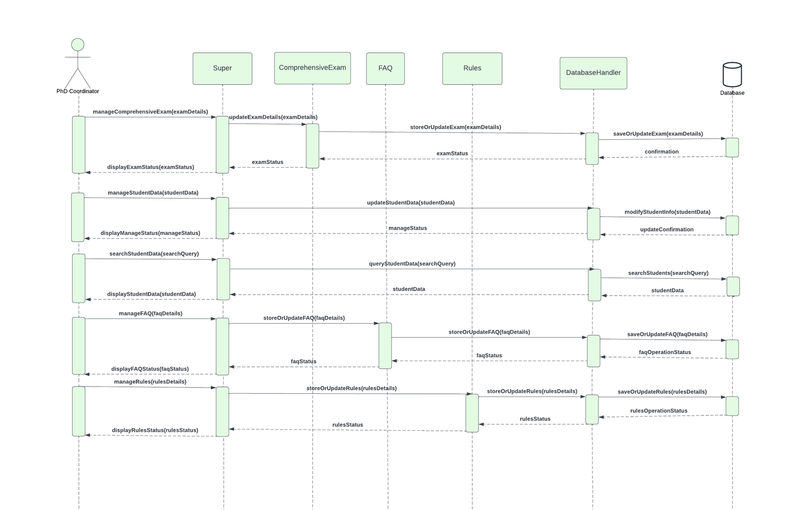
Sequence Diagram
NEW
20

Slide 27
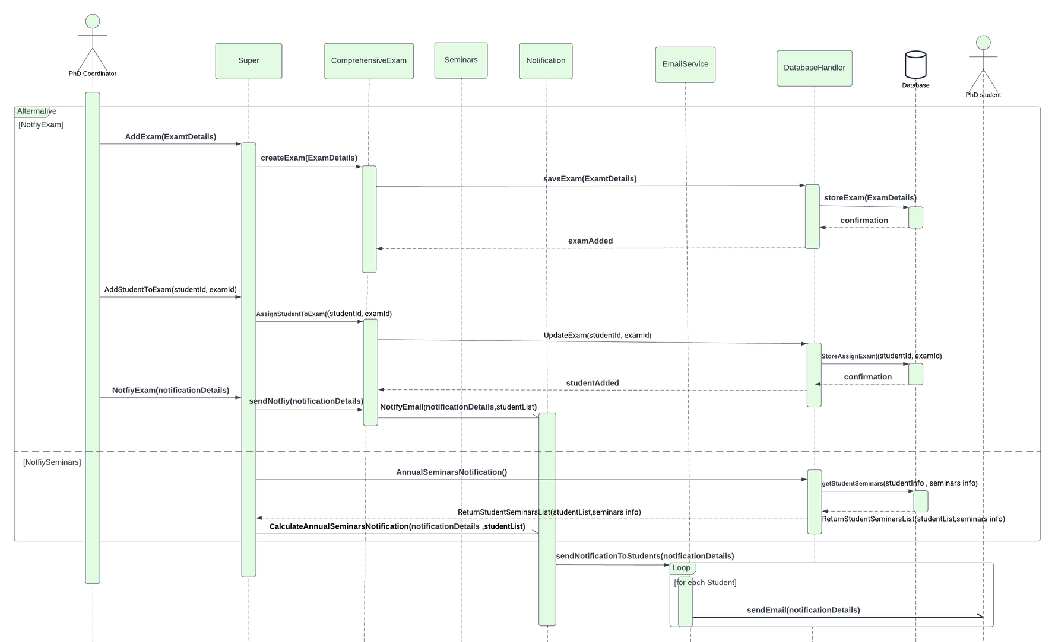
Sequence Diagram
NEW
21

Slide 28
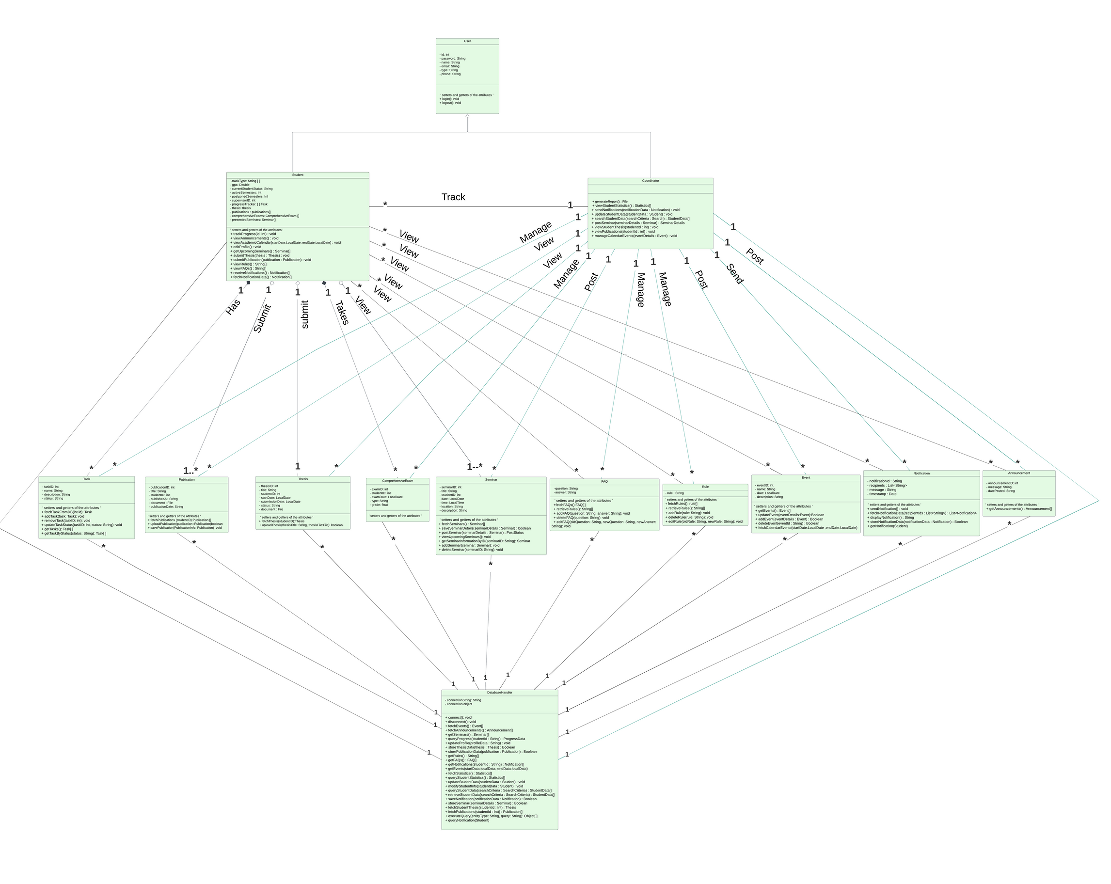
Class Diagram
OLD
22

Slide 29
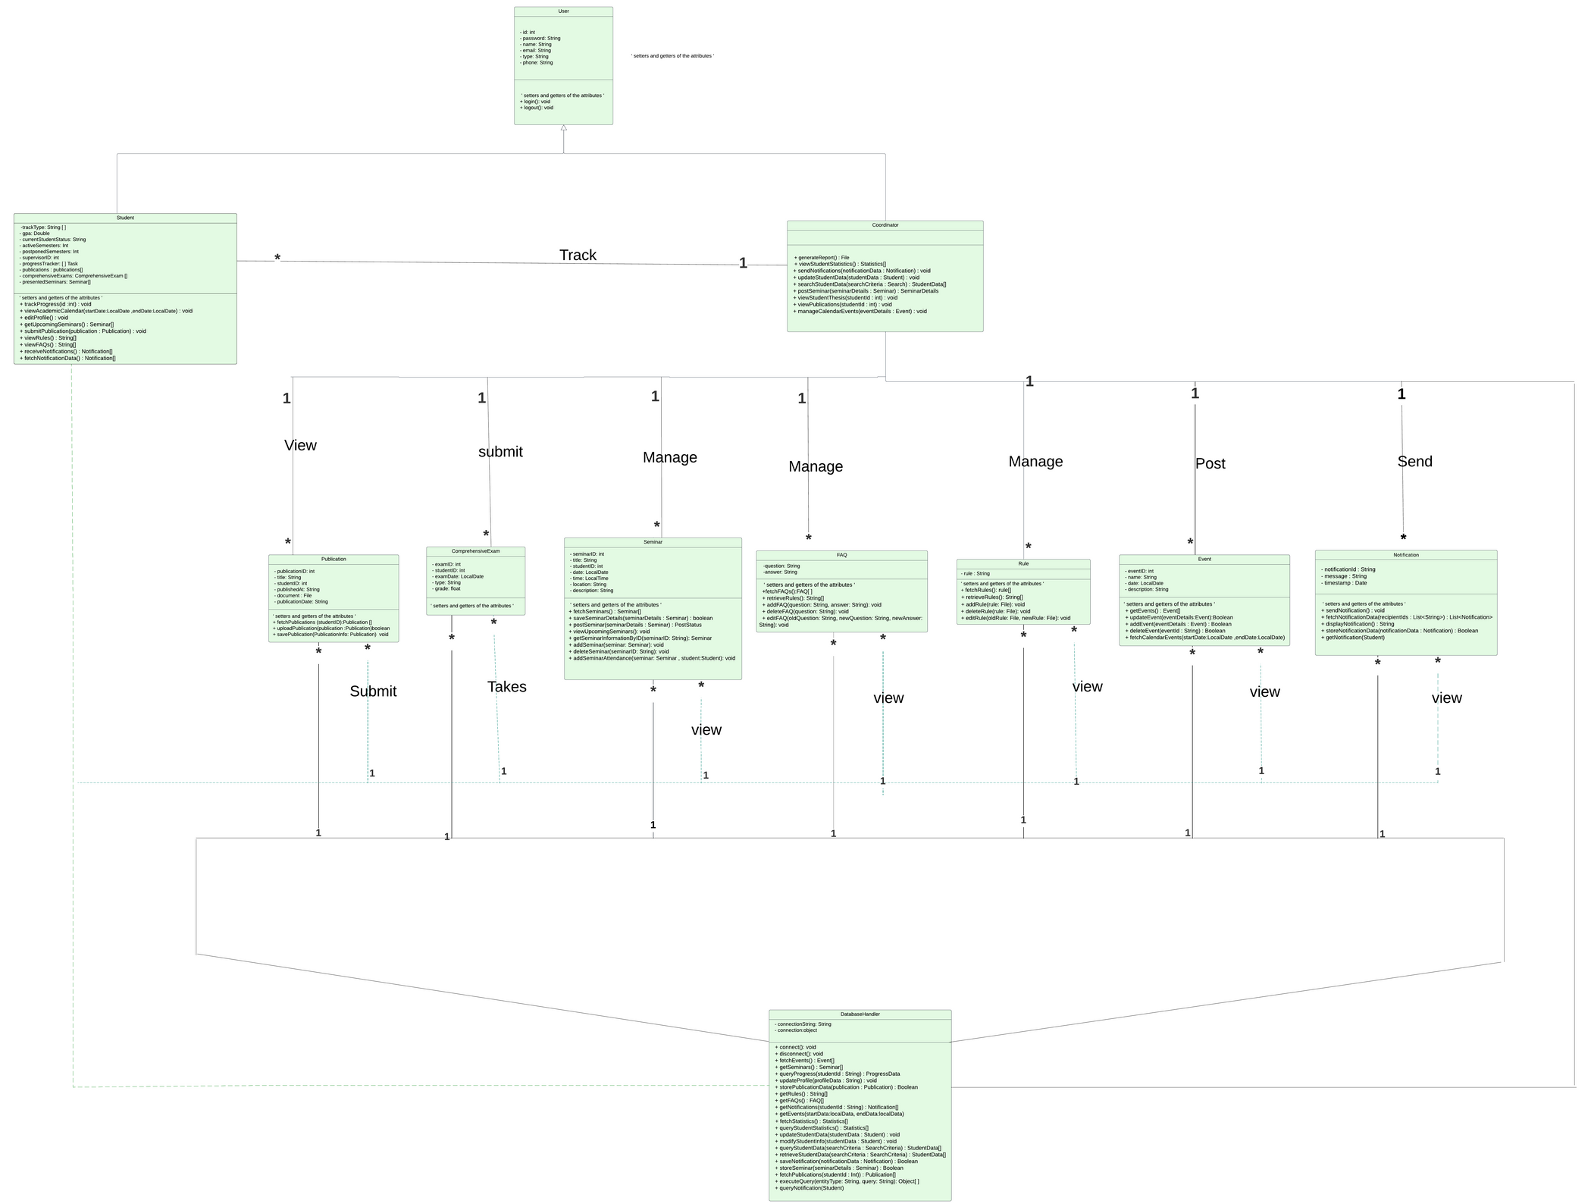
Class Diagram
NEW
23

Slide 30
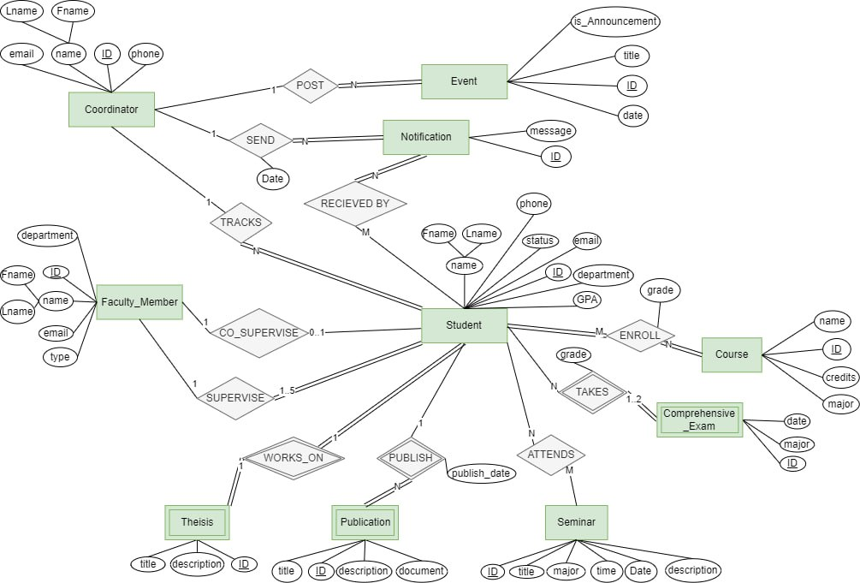
ER Diagram
24

Slide 31
Bashaier Alamoudi

Slide 32
Testing

Slide 33
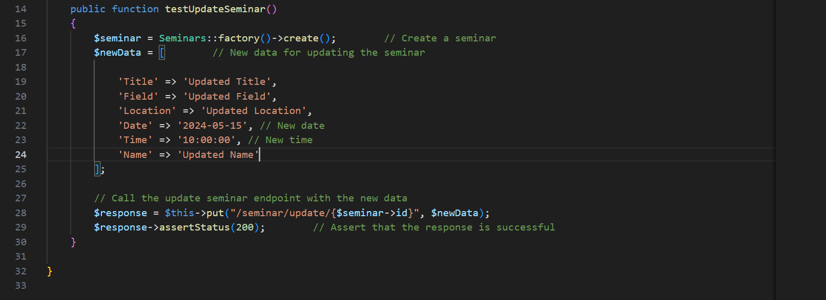
Unit Testing
for editSeminar
25

Slide 34
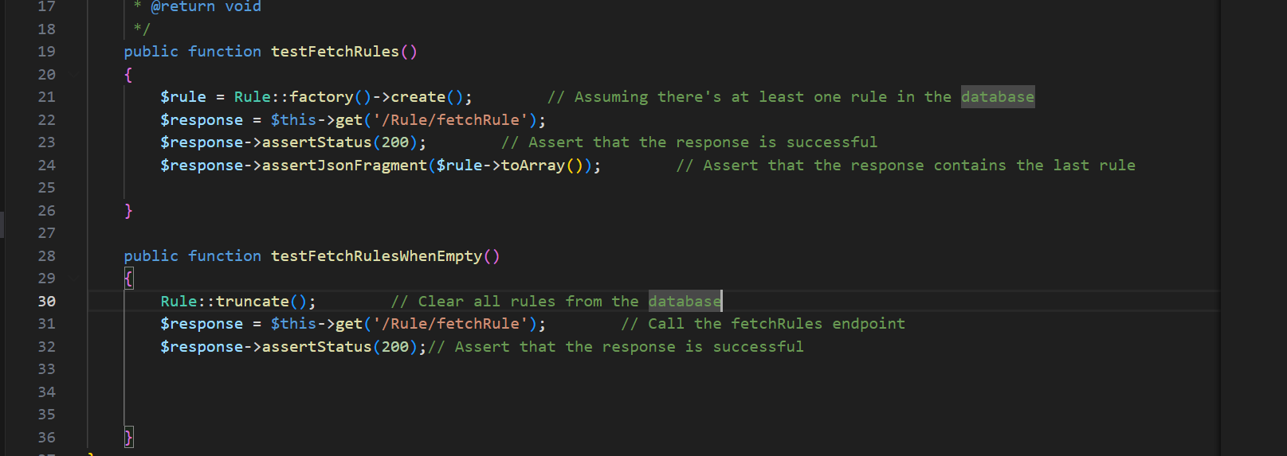
Unit Testing
for fetchRules
26

Slide 35
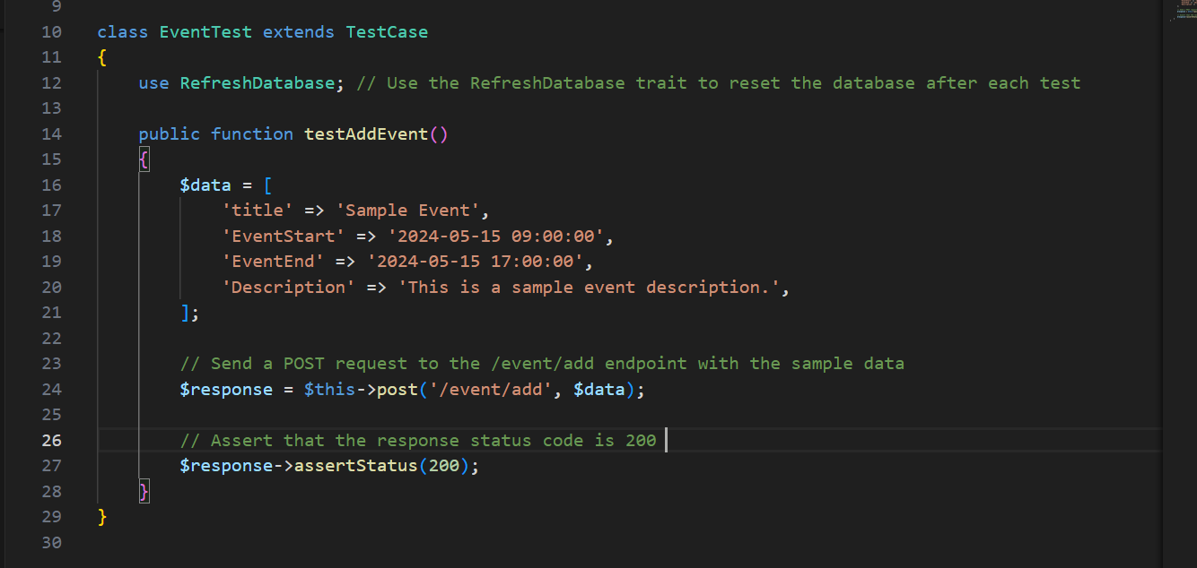
Unit Testing
for AddEvent
27

Slide 36
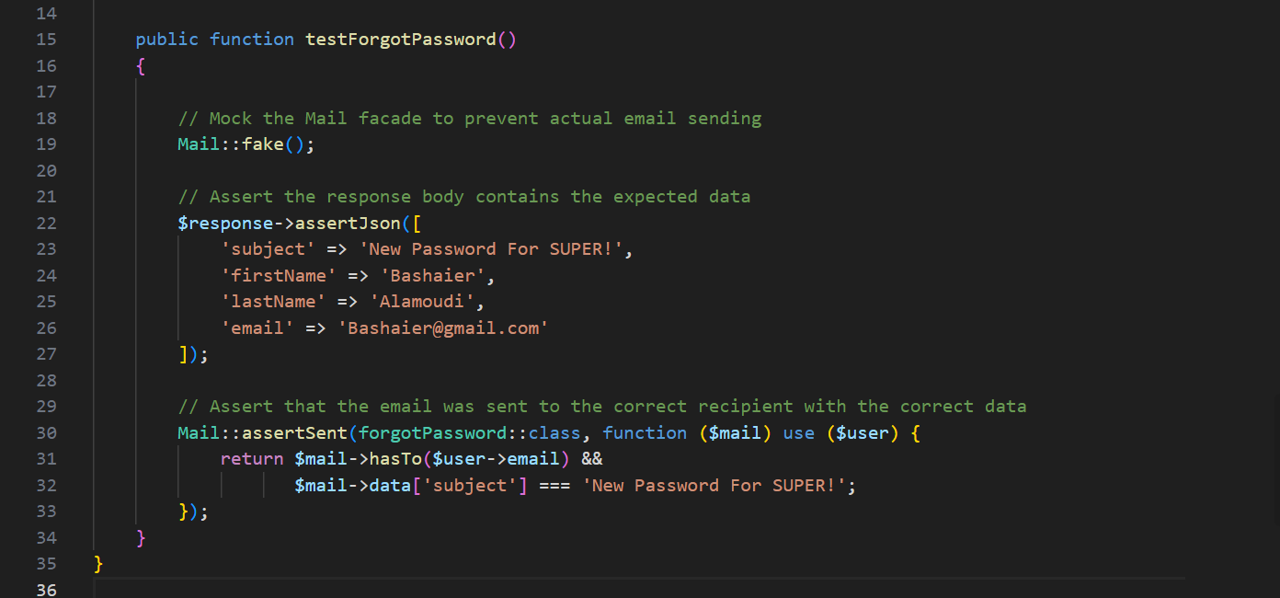
Unit Testing
for ResetPassword
28

Slide 37
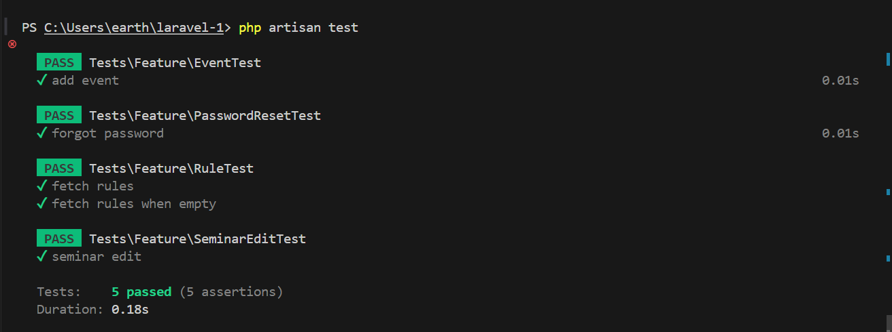
Unit Testing
for AddEvent
29

Slide 38

Compitability Testing
DEVICE | BROWSER | PASS/FAIL
WINDOWS | CHROME 123.0.6312.123 (64-BIT)
WINDOWS | FIREFOX 125.0.1(64-BIT)
WINDOWS | EDGE 124.0.2478.80(64-BIT)
MACBOOK PRO | SAFARI 17.4.1
30

Slide 39
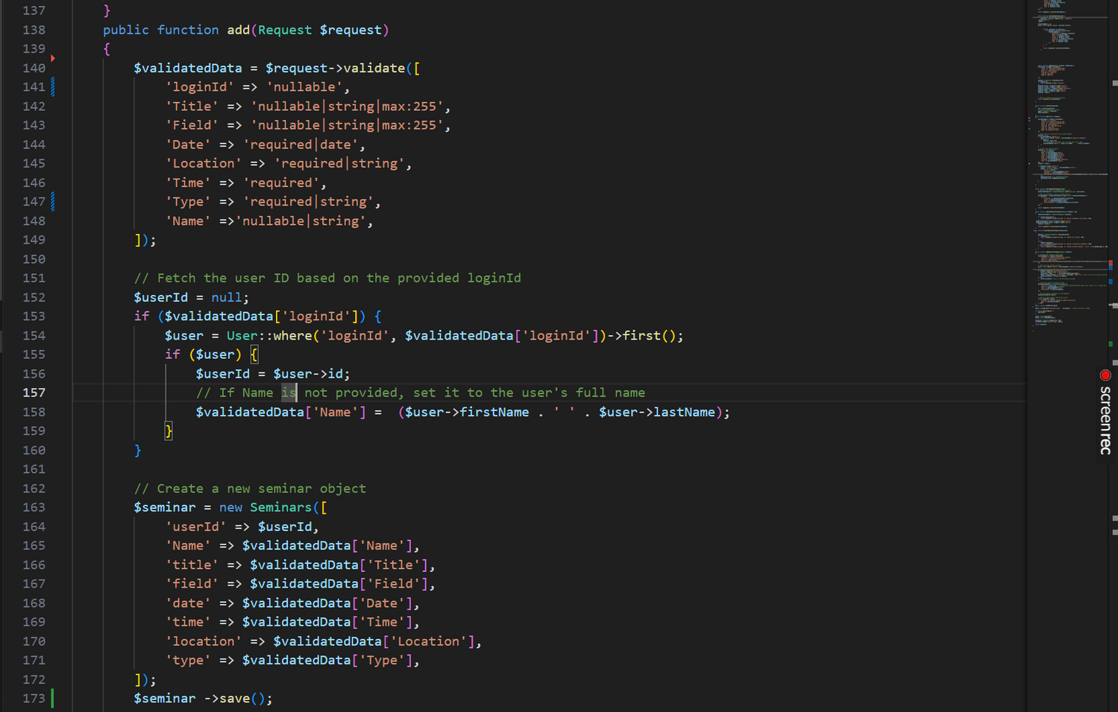
Integration Testing
31

Slide 40
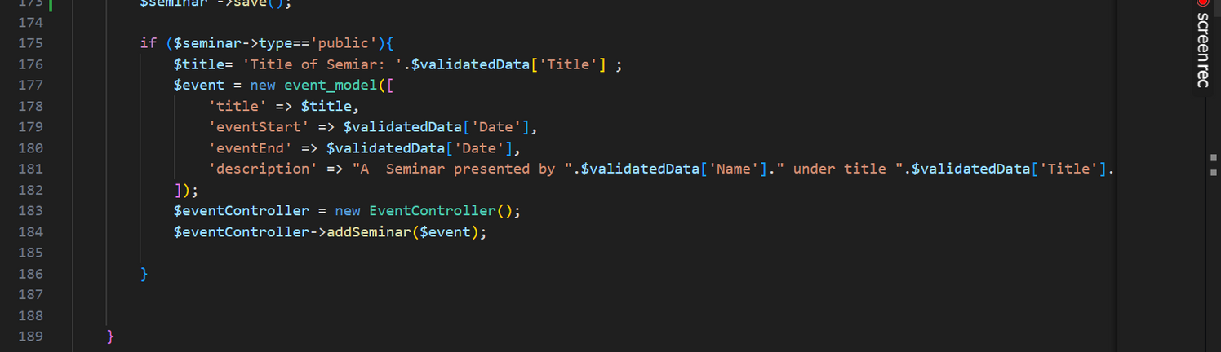
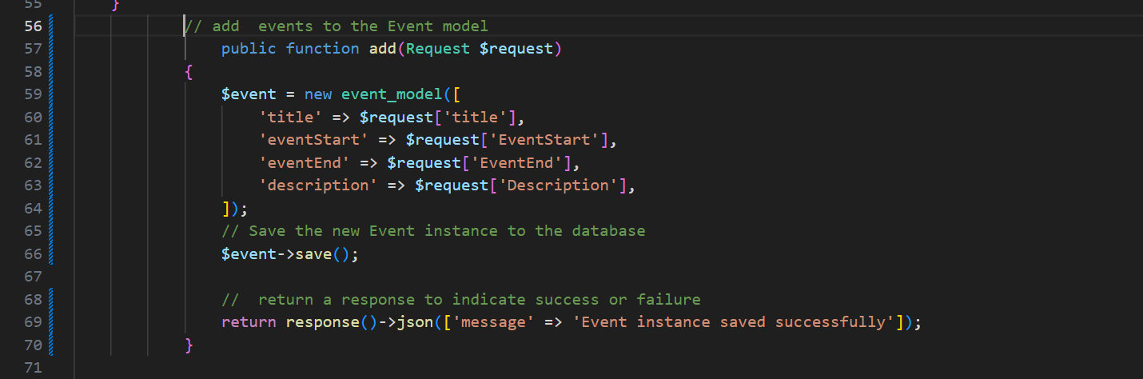
Integration Testing
32

Slide 41
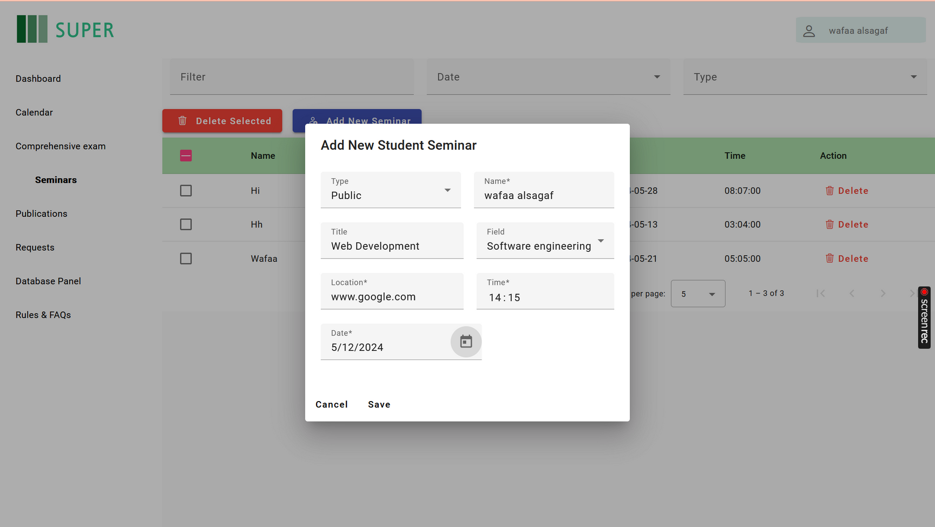
Integration Testing
33

Slide 42
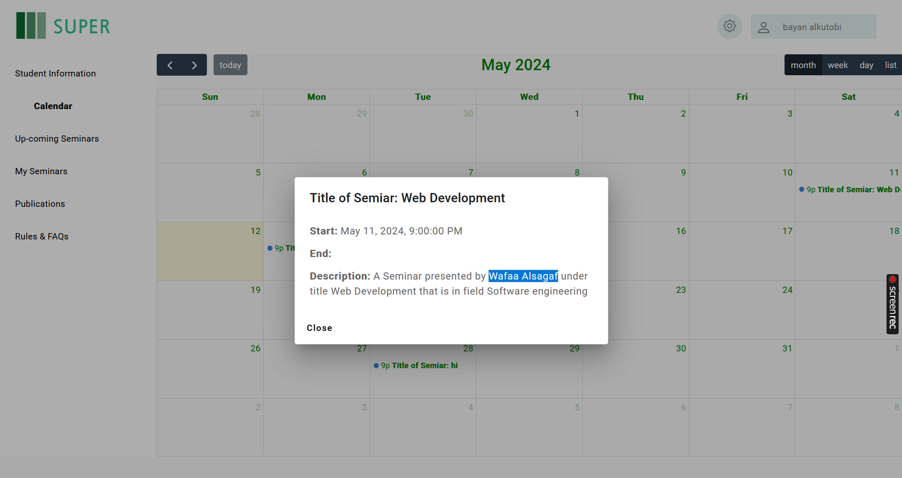
Integration Testing
34

Slide 43
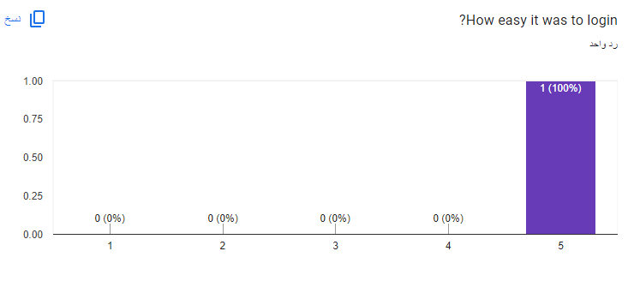
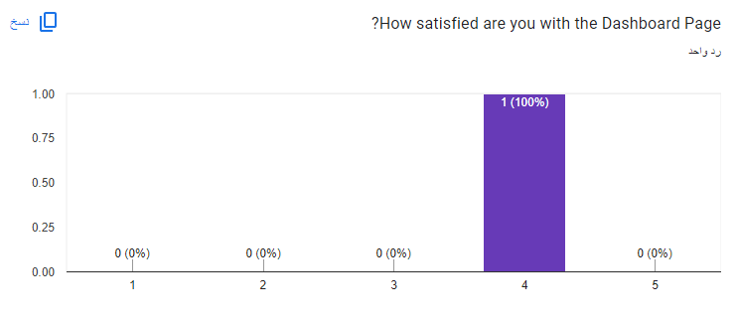
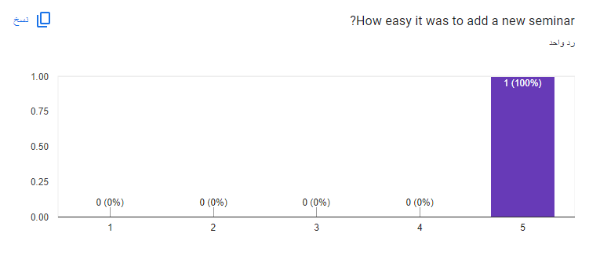
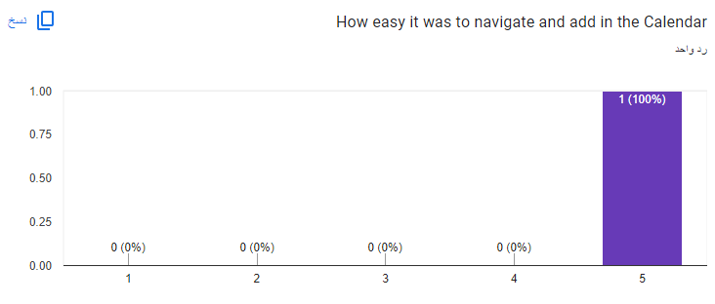
Usability Testing
35

Slide 44
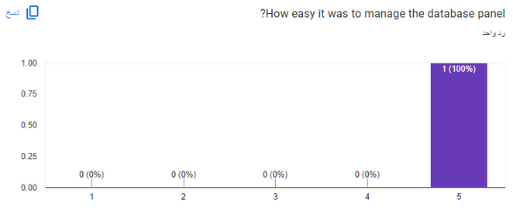
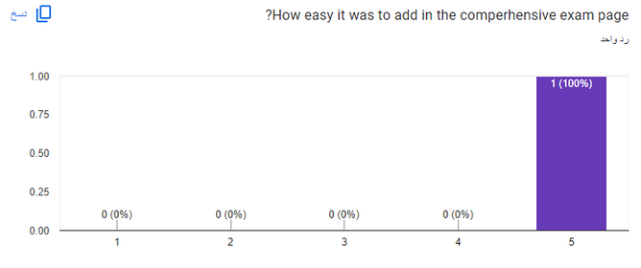
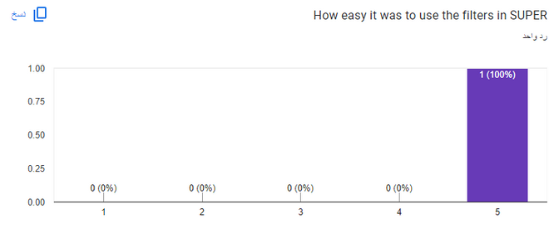
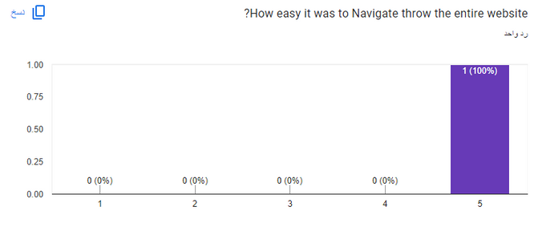
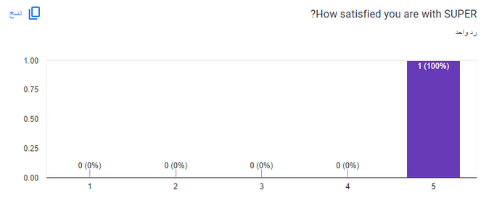
Usability Testing
36

Slide 45
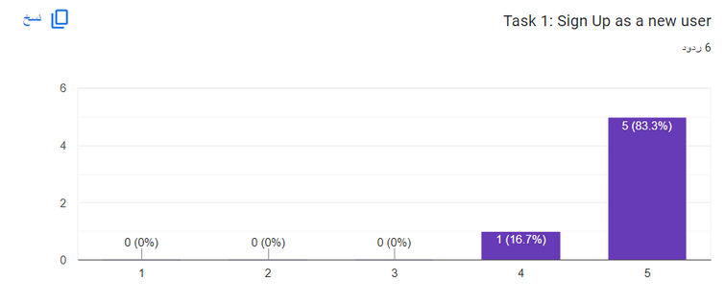
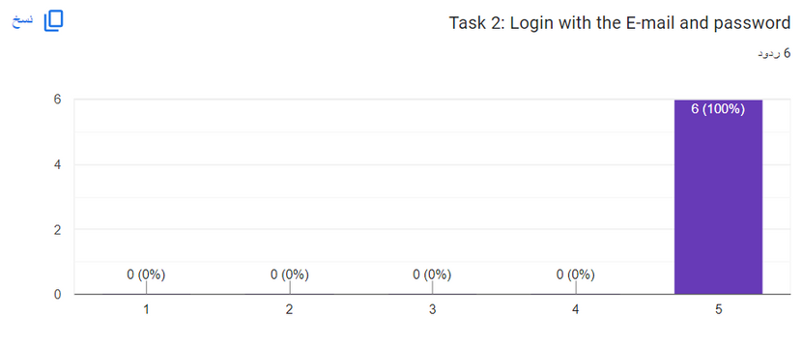
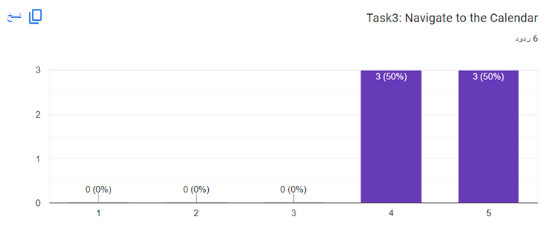
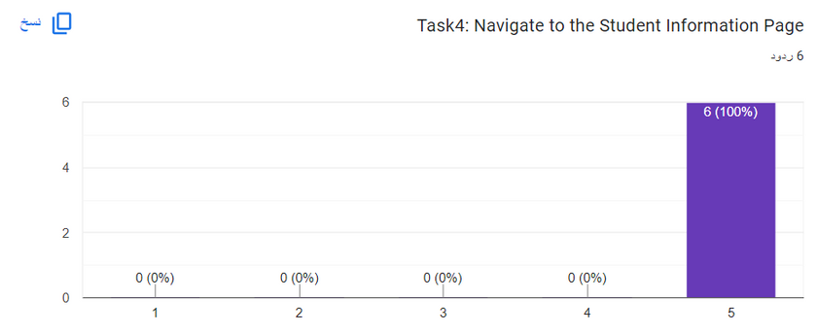
Usability Testing
37

Slide 46
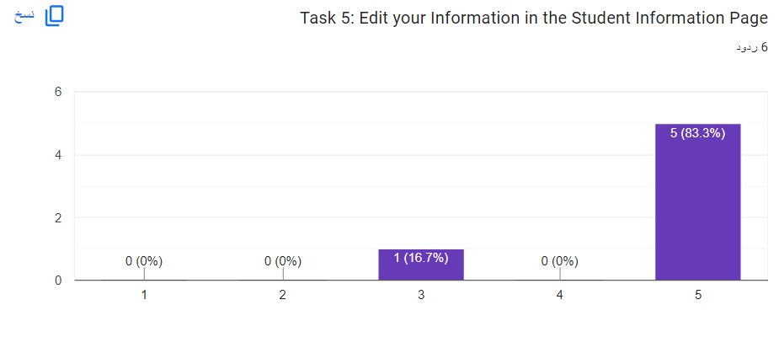
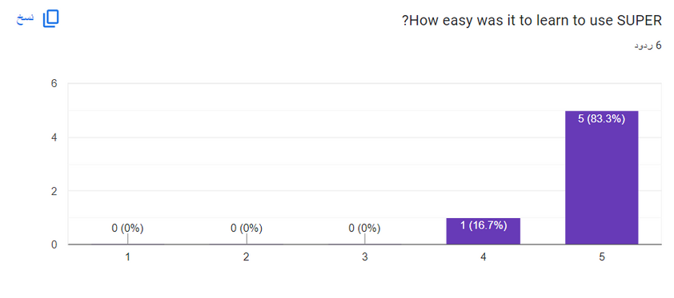
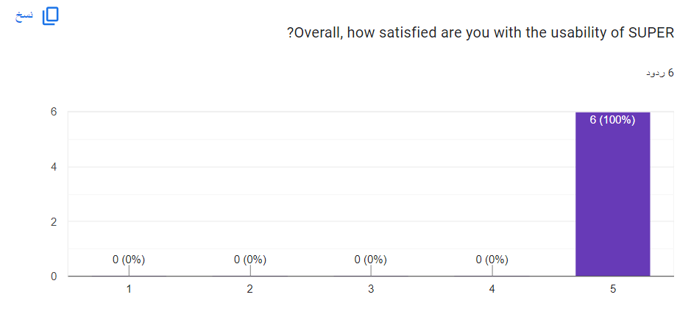
Usability Testing
38

Slide 47
Limitation & Future Work

Slide 48


Limitations
Not having an access as a supervisior
Only Support English language
39

Slide 49



Future Work
implement the Supervisor Side in the website
Devolop a version for the master program
The dashboard will feature a 'Generate Report' functionality,
40

Slide 50
Gadah Almuaikel

Slide 51
Result & conclusion

Slide 52
Login/Registeration

Slide 53
Login/Registeration
41

Slide 54
Login/Registeration
42

Slide 55
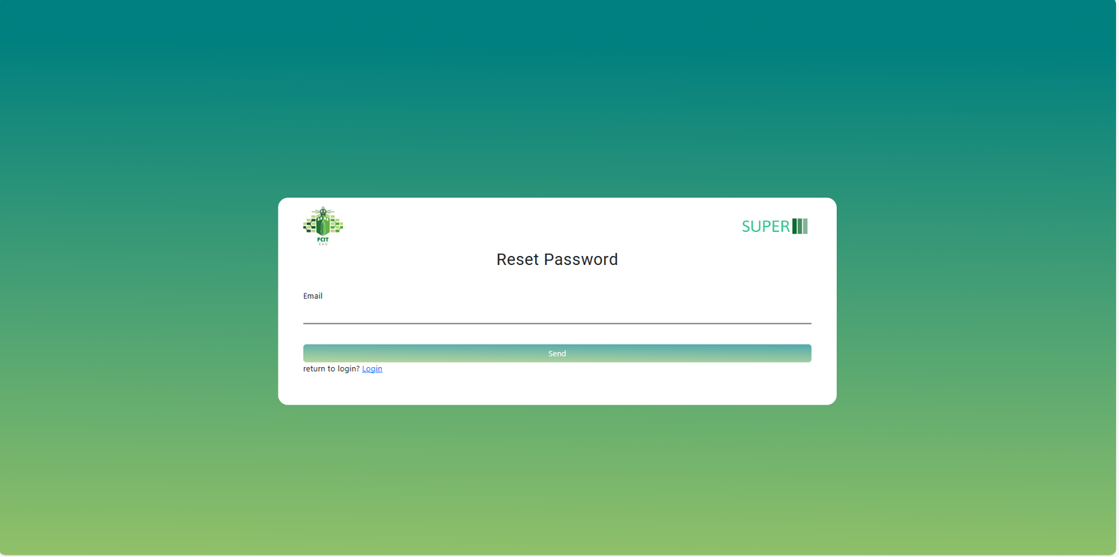
Login/Registeration
43

Slide 56
Requests

Slide 57

Requests - Coordinator
44

Slide 58

Requests - Coordinator
45

Slide 59
Student
infromation

Slide 60

Student infromation - student
46

Slide 61
Calendar

Slide 62

Calendar
47

Slide 63
Comprehensive exam

Slide 64

Comprehensive exam - Coordinator
48

Slide 65
Seminar

Slide 66

Requests - Coordinator
49

Slide 67

Seminar - Coordinator
50

Slide 68

Seminar - Student
51

Slide 69

Seminar - Coordiantor
52

Slide 70
Rules/FAQ

Slide 71

Rules/FAQ
53

Slide 72
Publication

Slide 73

Publication - Student
54

Slide 74

Publication - Coordinator
55

Slide 75
Dashboard

Slide 76

Dashboard - Coordinator
56

Slide 77
Database panel

Slide 78

Database panel - Coordinator
57

Slide 79
THANK YOU
Any Questions?

